Slide 1





AI powered project for study
TEAM NAME :- SMART SCHOLARS
TEAM LEADER :- HARSH LODHI
TEAM MEMBERS :- JOGENDRA SINGH SEN , KALASH TIWARI
COLLEGE ADDRESS :- SISTec GANDHINAGAR , OPPOSITE AIRPORT BHOPALL, M.P.

Slide 2
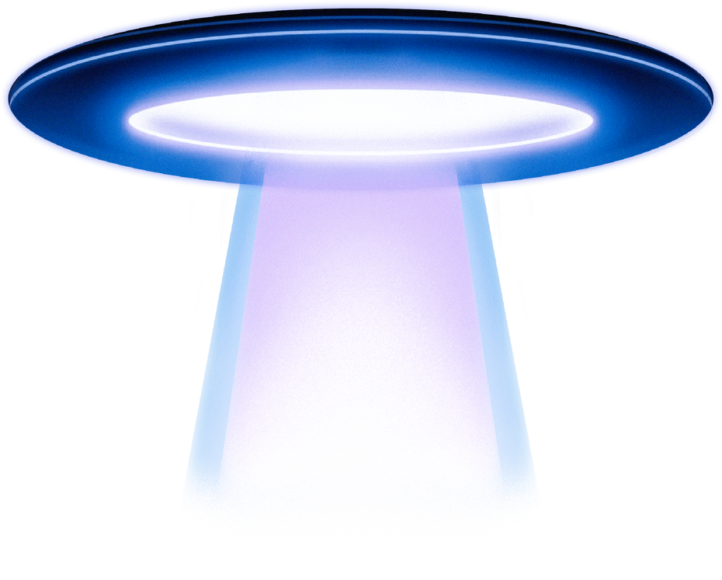


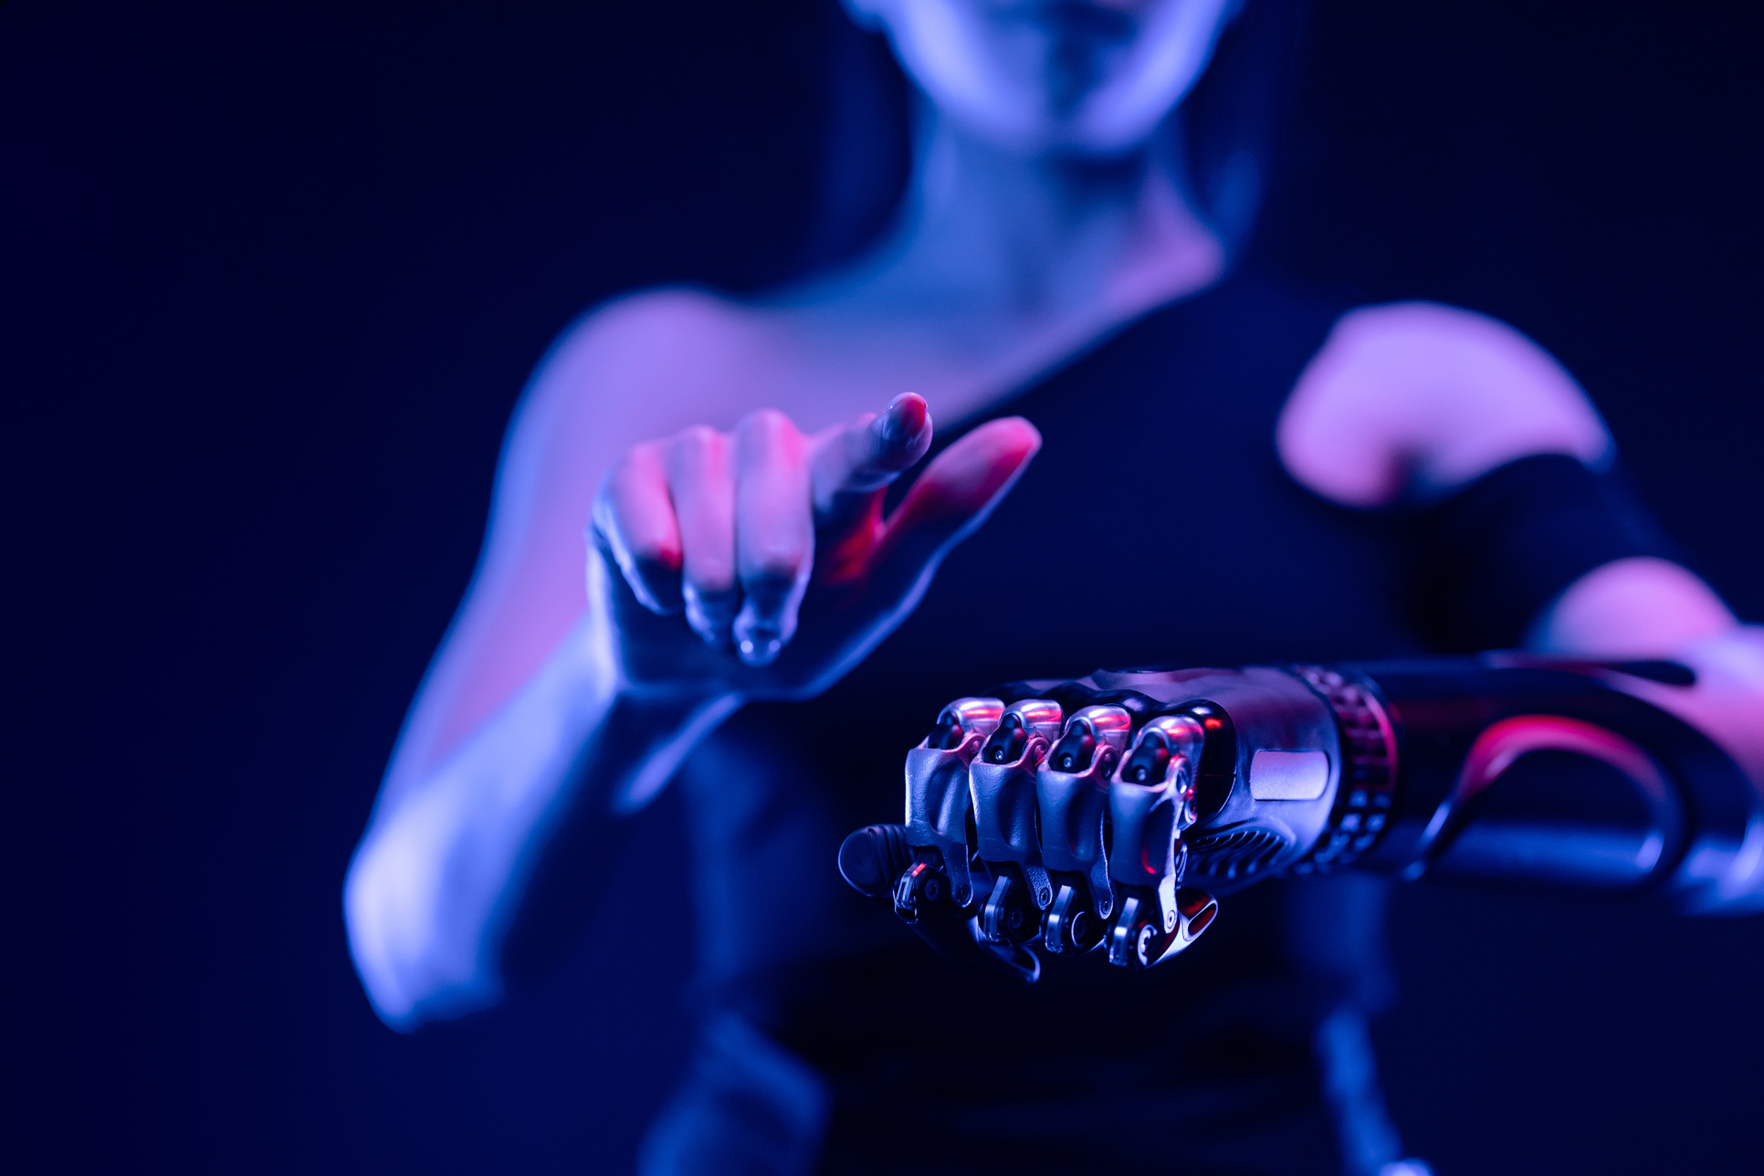
PROJECT OVERVIEW
A challenge to build an AI platform that ingests diverse learning resources (text, PDF, video, images) and automatically produces interactive study aids.

Slide 3
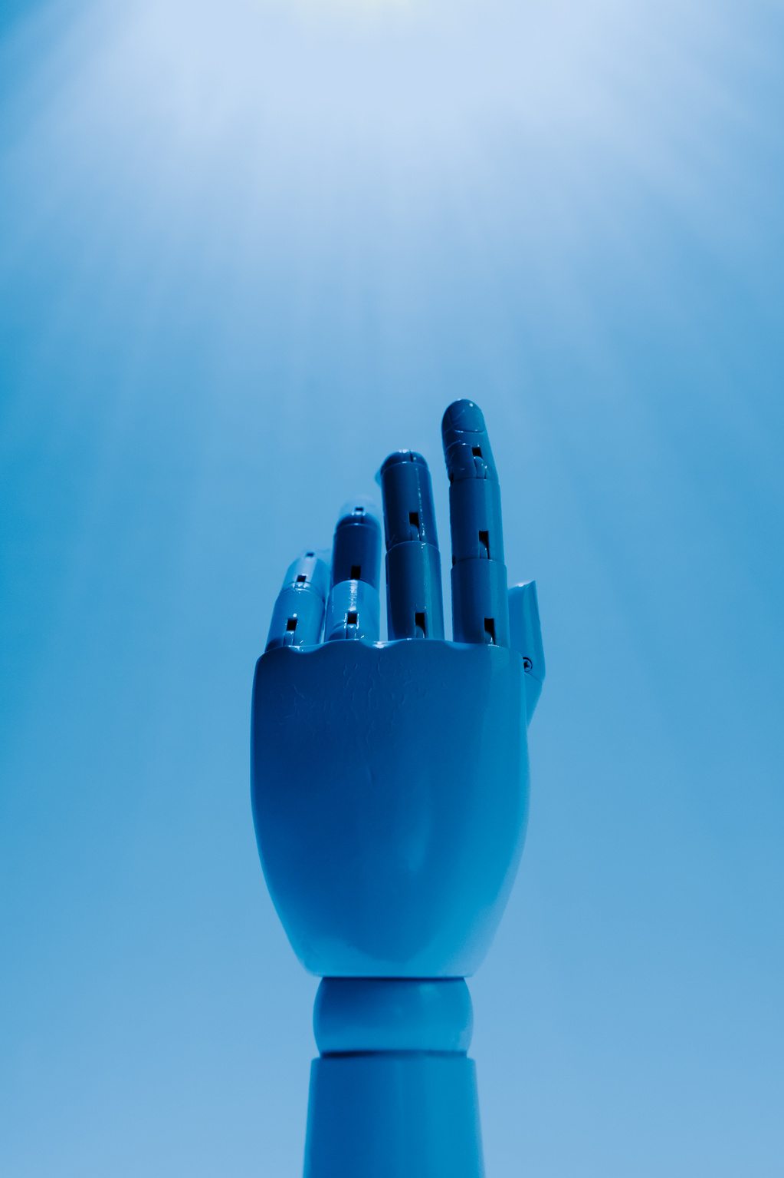

PROBLEM STATEMENT
Educators and learners spend excessive time creating practice questions and visual summaries.
Existing tools are fragmented—few cover both question generation and visual aids in one place.

Slide 4

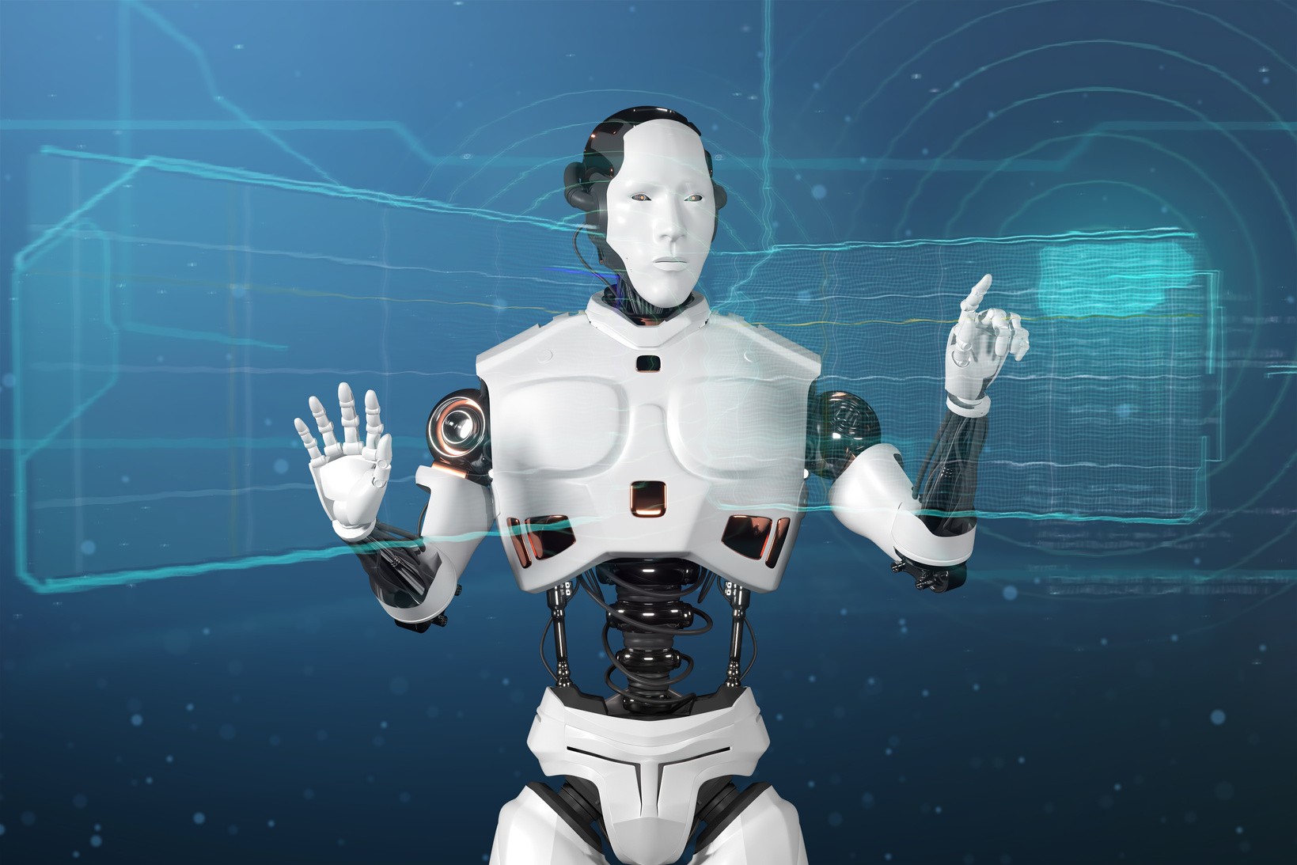
Multi- modal input Processing
- Text notes & PDFs
- Recorded lectures (audio/video)
- Diagrams & photographs
Automated content generation
- MCQs, True/False, Fill-in-the-Blanks, Short Q&A
- Customizable difficulty and topic focus
CORE SOLUTION
Visual summaries
- Flashcards (front/back format)
- Flowcharts mapping concepts and process flows

Slide 5
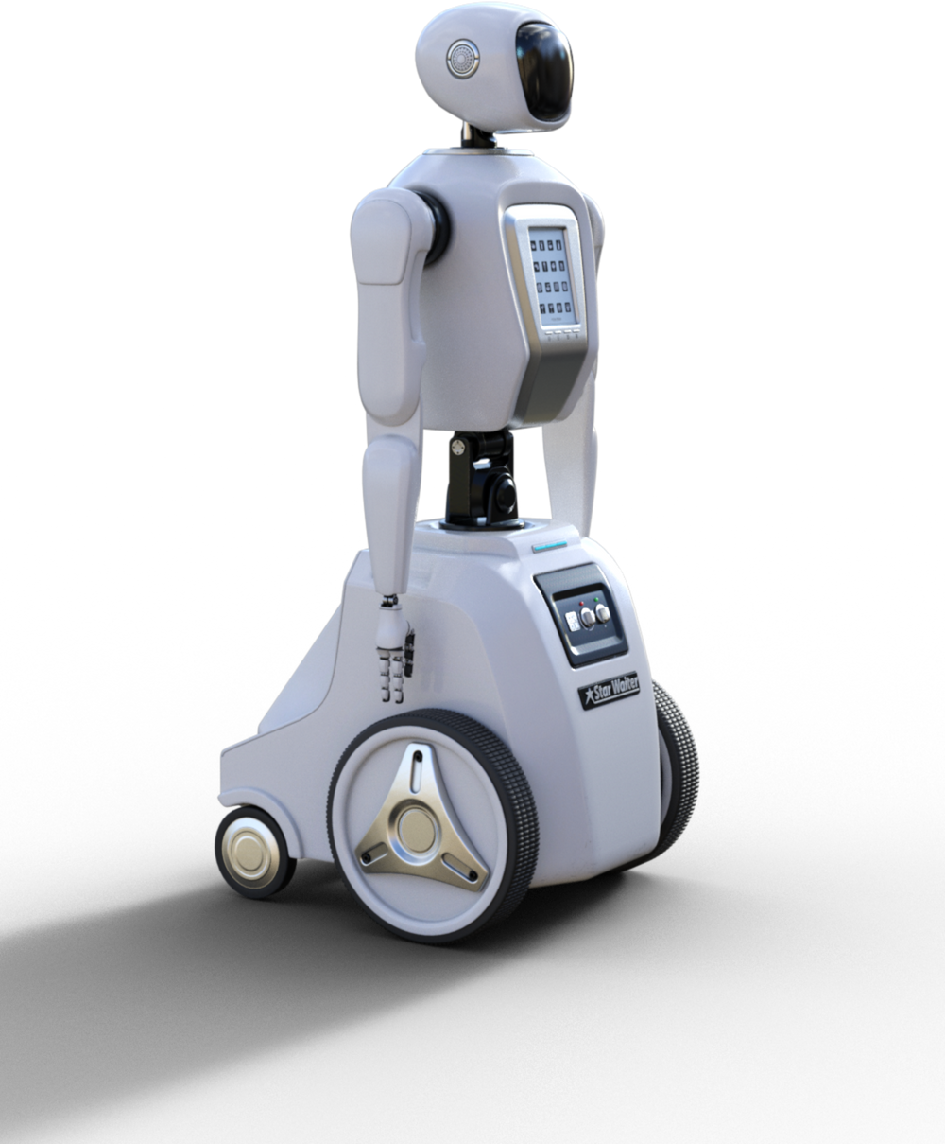

KEY FEATURES & WORKFLOW
Upload Module
- Drag-and-drop interface for files & media
AI Engine
NLP for text parsing & question generation
Template Customizer
Select question types, visual styles, output formats
Export & Integrations
Download as PDF/PPT/CSV

Slide 6


AI TECHNOLOGIES USED
WE ARE USING VARIOUS ARTIFICIAL INTELIGENCE TOOLS (OPEN AL, GEMINI PRO
PROGRAMMING LANGUAGES USED :-
PYTHON (BACKEND), HTML (FRONTEND)

Slide 7

FUTURE
POTENTIAL OF AI
TIIME-SAVING
CONSISTENCY
ENGAGEMENT
ACCESSIBILITY
Automates labor-intensive preparation
Standardized quality across materials
Interactive exercises and visual aids boost retention
Supports diverse learning styles

Slide 8
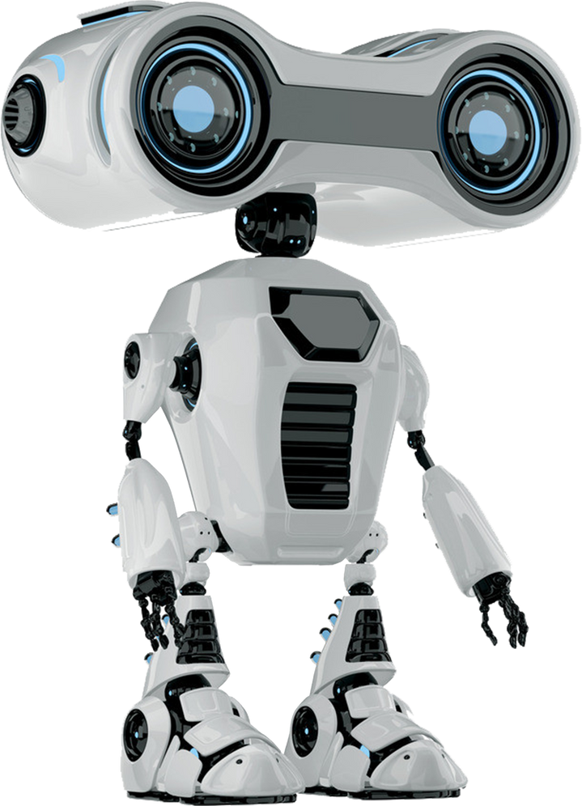
HACKATHON HIGHLIGHTS
Team Formation
Cross-disciplinary (AI, UX, education)
Ethical Considerations and Challenges
Accuracy & relevance of generated questions
- Quality of visual aids (legibility, coherence)
- UI/UX intuitiveness
- Scalability & integration capabilities

Slide 9
CONCLUSION
High educational impact: saves time, enhances learning
clear hackathon metrics: accuracy, UX, scalability

Slide 10
THANKYOU
FOR YOUR ATTENTION
lodhiharshlodhi181@gmail.com

